Slide 1
Programming In QTP - I

Slide 2
Programming In QTP - I
In QuickTest, Test scripts are composed of statements coded in Microsoft's programming language, VBScript.

Slide 3
About Expert View
QuickTest can display tests you record in two formats:
  The Tree View, where QuickTest displays the object hierarchy in an icon-based tree
  The Expert View, where QuickTest displays the object hierarchy in VBScript
The Expert View provides an alternative to the Tree View for testers who are familiar with VBScript.
In the Expert View, you can view the recorded test in VBScript and enhance it with programming.

Slide 4
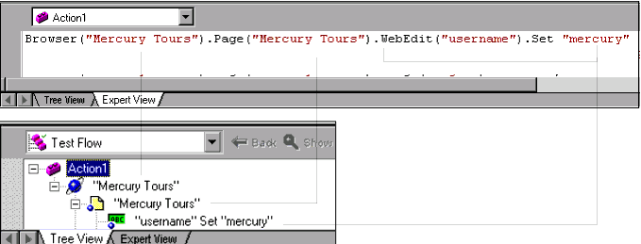
Each line of VBScript in the Expert View represents a step in
the test.

Slide 5
Programming In Expert View
QuickTest enables you to incorporate decision-making into your test by adding conditional statements that control the logical flow of your test.
In addition, you can define messages in your test that QuickTest sends to your test results.
To improve the readability of your tests, you can also add comments to your test.

Slide 6
What Is VBScript?
Microsoft Visual Basic Scripting Edition brings active scripting to a wide variety of environments, including
  Web client scripting in Microsoft Internet Explorer and
  Web server scripting in Microsoft Internet Information Service.

Slide 7
Features Of VBScript
Array Handling
Assignments
Comments
Control Flow
Conversions
Dates/Times
Declarations
Formatting Strings
Input/Output
Math
Operators
Procedures
Strings

Slide 8
DataType
VBScript has only one data type called a Variant.
A Variant is a special kind of data type that can contain different kinds of information, depending on how it is used.
A Variant Can contain Empty, Null, Boolean,Byte, Integer, Currency, Date(Time), String, Object, Error Code

Slide 9
Variables
A variable is a convenient placeholder that refers to a computer memory location .
Declaring Variables:
  You declare variables explicitly in your script using the Dim statement, the Public statement, and the Private statement. For example:
    Dim DegreesFahrenheit
  You declare multiple variables by separating each variable name with a comma.

Slide 10
Assigning Values to Variables:
  Values are assigned to variables creating an expression as follows: For example:
    B = 200
Array Variables:
  Array variables and scalar variables are declared in the same way, except that the declaration of an array variable uses parentheses ( ) following the variable name. In the following example, a single-dimension array containing 11 elements is declared:
    Dim A(10)
  You assign data to each of the elements of the array using an index into the array. Beginning at zero and ending at 10, data can be assigned to the elements of an array as follows:
      A(0) = 256
      A(1) = 324
      A(2) = 100

Slide 11
Constants
You create user-defined constants in VBScript using the Const statement. Using the Const statement, you can create string or numeric constants with meaningful names and assign them literal values. For example:
  Const MyString = "This is my string."
  Const MyAge = 20

Slide 12
Operators
Arithmetic operators
Comparison operators
Concatenation operators
Logical operators.

Slide 13
Conditional Statements
QuickTest enables you to incorporate decision-making into your test by adding conditional statements that control the logical flow of your test.
In addition, you can define messages in your test that QuickTest sends to your test results. To improve the readability of your tests, you can also add comments to your test.

Slide 14
If …Then…Else
The If...Then...Else statement instructs QuickTest to execute a statement or a series of statements based on specified conditions. If a condition is not
fulfilled, the next elseif or else statement is examined.
Your If...Then...Else statement can be nested to as many levels as you need. It has the following syntax:

Slide 15
If condition Then statements
[Else elsestatements] End If
Or, you can use the block form syntax:
If condition Then
[statements]
[ElseIf condition-n Then
[elseifstatements] . . .
[End If]
[Else
[elsestatements]
End If
To add a conditional statement to your test:
Insert > Step > Conditional Statement > If...Then.

Slide 16
“For...Next” Statement
A For...Next loop instructs QuickTest to execute one or more statements a specified number of times. It has the following syntax:
counter - the variable used as a counter.
Start - the start number of the counter.
end - the last number of the counter.
Step - the number to increment at the end of each loop. The default is 1.
statement - the statement to be executed during the loop.
for counter = start to end [Step step]
statement
Next

Slide 17
“For…Each”
A For...Each loop instructs QuickTest to execute one or more statements for each element in an array or an object collection. It has the following syntax:
item - a variable representing the element in the array.
Array - the name of the array.
statement - a statement or series of statements to be executed during the loop.
For Each item In array
statement
Next

Slide 18
“Do…Loop”
The Do...Loop statement instructs QuickTest to execute a statement or series of statements while a condition is true or until a condition becomes true. It has the following syntax:
Condition - a condition to be fulfilled.
Statement - a statement or series of statements to be executed during the loop.
Do [{while}{until}condition]
statement
Loop

Slide 19
“While”
A While statement instructs QuickTest to execute a statement or series of statements while a condition is true. It has the following syntax:
While condition
statement
Wend

Slide 20
“With”
With statements make your script more concise and easier to read by grouping consecutive statements with the same parent hierarchy.
The With statement has the following syntax.
Object - an object or a function that returns an object.
statements - one or more statements to be executed on an object.
With object
statements
End With

Slide 21
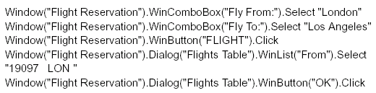
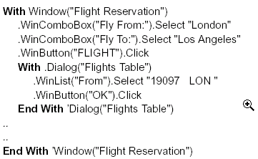
Example
Without “with” statements”:
Using “with” statements”:

Slide 22
Sending Messages to Your Test Results
You can define a message in your test that QuickTest sends to your test results.
Insert > Step > Report
Select the status that will result from this step from the Status list.
In the Name box, type a name for the test step. For example, “Password edit box”.
In the Details box, type a detailed description of this step to insert in your test results.
Click OK.
  A report step is inserted into the test tree and a ReportEvent statement is inserted into your script in the Expert View

Slide 23
Report Message : An Example
Reporter.ReportEvent 1, "Password edit box", "Password edit box does not exist"
Where “1” indicates the status of the report (failed), “Password edit box” is the report name, and “Password edit box does not exist” is the report message.

Slide 24
Adding Comments
While programming, you can add comments to your tests.
  A comment is an explanatory remark in a program.
When you run a test, QuickTest does not process comments.
Use comments to explain sections of a test to improve readability and to make tests easier to update.

Slide 25

To add a comment:
Insert > Step > Comment
Type a comment and click OK.
  A comment statement is added to your test. If you are working in the Tree View, the icon indicates a comment. In the Expert View, a comment is specified with apostrophes ( ' ).

